Slide 1

Spotted Python
Week 1 Tutorial
Course Reminders
GitHub Setup
Markdown

Slide 2
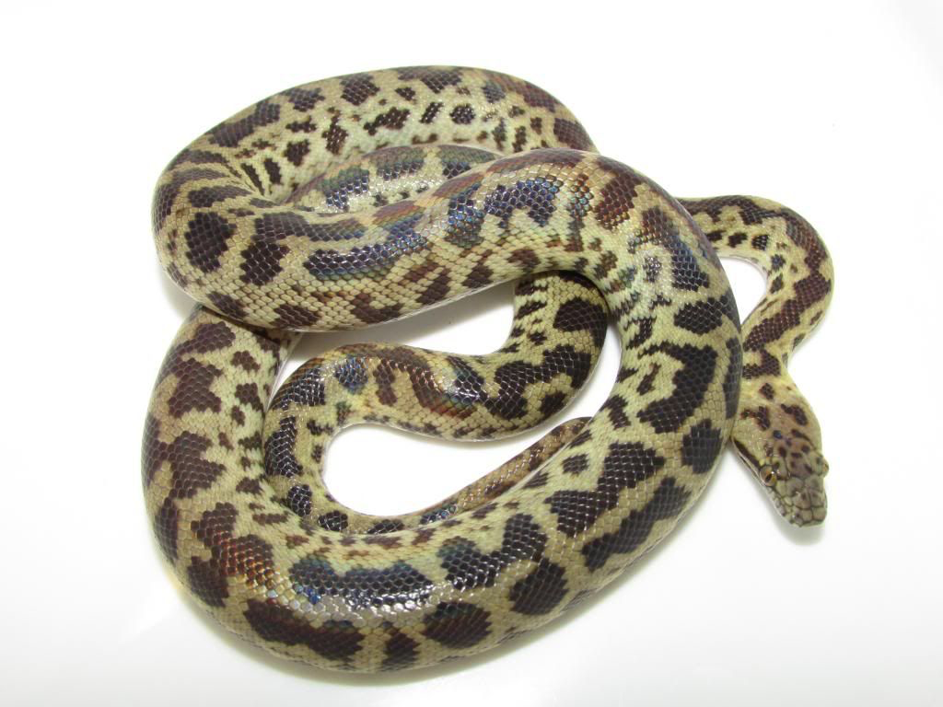

Welcome Spotted Pythons
Coding is an important skill for astrophysics
This stream is designed to learn coding at a slower pace
All examples and materials are the same across the 2 streams, but approached in different ways
Finn will be the tutor for Morelia
I am a small friendly snake!
If you have any questions, ask in tutorials, on the forum or via email
(michelle.ding@unsw.edu.au)

Slide 3
Welcome Spotted Pythons
Coding is an important skill for astrophysics
This stream is designed to learn coding at a slower pace
All examples and materials are the same across the 2 streams, but approached in different ways
Finn will be the tutor for Morelia

Slide 4
Michelle (she/her)
3rd year PhD student
Wanted to be a singer before I was 11
Decided to be an astronomer after I watched a documentary about Black Holes

Slide 5


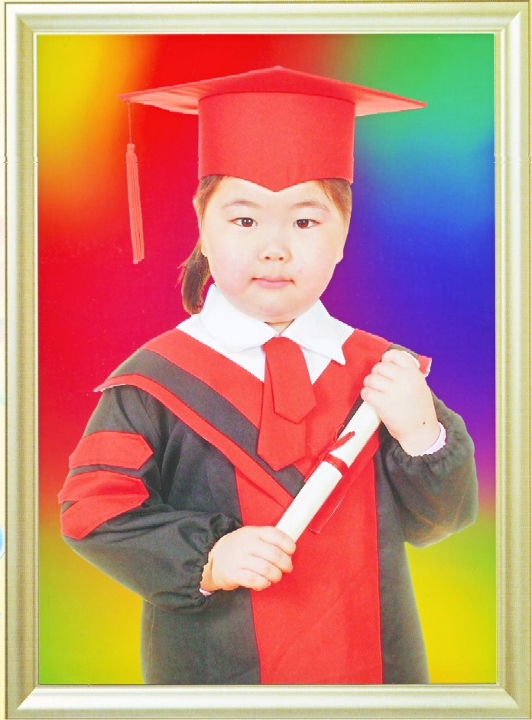
Michelle (she/her)
At university I jumped around multiple research groups
  Undergrad research – pipeline to distinguish between good and bad data
  Honours research – strong lensing in group environments
  PhD research – PhD structures in edge-on galaxies
I love teaching, singing, dancing, travelling, going to markets, and seeking out good vegetarian food

Slide 6
I want to hear from you
What is your name
What part of astronomy are you most excited about to learn/most interested in?
Please give me feedback. I want you to govern what these tutorials are about!

Slide 7

Reminders
The computational assignment involves collaboration
  Each team will have a 5–10 minutes team meeting each week.
  You need to attend at least 3 meetings
  Group code must be developed on GitHub.
  You must commit lines of code and documentation for at least 3 weeks
  Commits must contain meaningful analysis
  We may ask you to explain your code to us
Responsible AI use
  AI references can be wrong
  Everything you write can be examinable
  All materials covered in the tutorials can be examinable
  We can tell AI-generated code apart from originally written code

Slide 8

Why use GitHub
Backup of code to reduce the chances of you losing your work
Version control
Automation tools for building and testing your work
Store and present documentation
Recognition for your work
If you are confused by this GitHub tutorial, refer to the following links (there are different ways to setup GitHub):
  https://adacs-australia.github.io/2023-03-20-Coding-Best-Practices-Workshop/GitHub/index.html
  https://code.visualstudio.com/docs/sourcecontrol/github

Slide 9
Setting up Python and GitHub
Sign up for a free GitHub account: https://github.com/
Install GitHub Desktop: https://desktop.github.com/download/
Install VS Code: https://code.visualstudio.com/
Install Miniconda: https://www.anaconda.com/docs/getting-started/installation

Slide 10
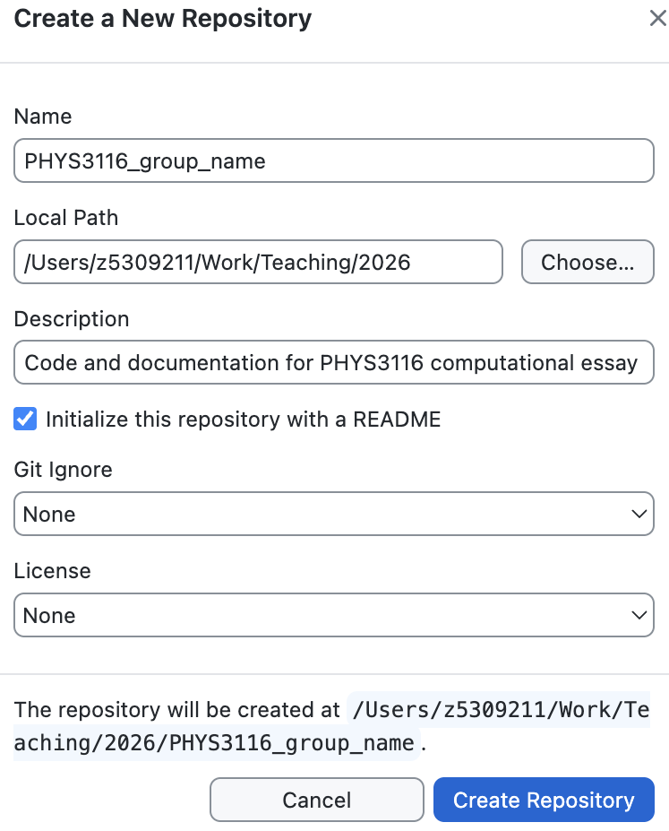
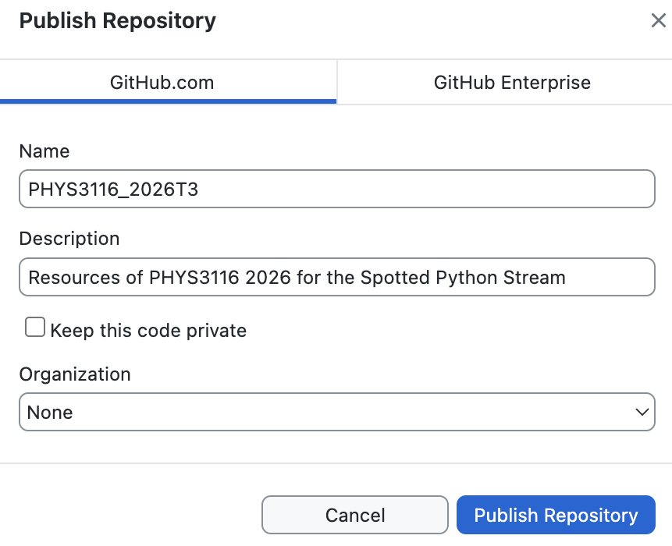
Making a new repository
Open GitHub Desktop
Select File → New Repository
Enter the name, location you want to save the repository, a description, and tick “Initialize this repository with a README”
Check that the file now exists locally on your laptop
Publish the repository

Slide 11
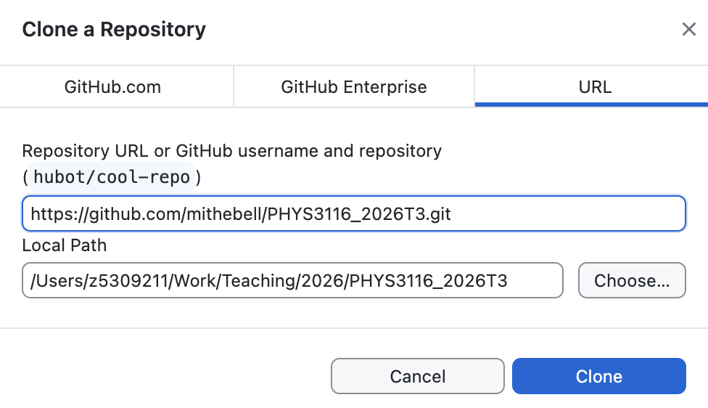
Cloning a repository
Go to GitHub website and check your repository is published
We will now clone my repository that you will use for weekly resources
  Copy this link: https://github.com/mithebell/PHYS3116_2026T3.git
  Go back to GitHub Desktop
  File → Clone Repository → URL
  Paste in the link and clone
To push or

Slide 12
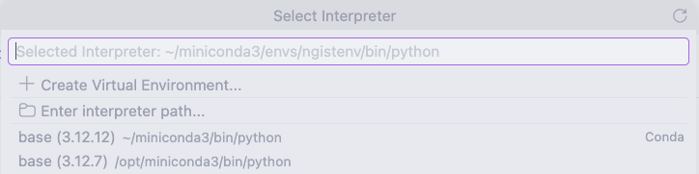
Making a new Python file
Open VS Code
At the top search bar type in: >Python: Select Interpreter
  Choose the base environment from miniconda3 (it should have Conda next to it)
File → New File → Python File/Jupyter Notebook
Save Python Script or Jupyter Notebook in YOUR repository

Slide 13
Committing to GitHub
Open GitHub Desktop
Your new change should have shown up as a changed file
Tick the change you want to commit → Commit to main
  Here main means you are on the main branch
  Branching and forking is not required for this course

Slide 14
Working collaboratively on GitHub
Have one shared GitHub repository for each group
Clone GitHub Desktop onto your laptop
At the start of every coding session:
  Go to GitHub Desktop
  Repository → Pull
  Make sure your laptop is up to date with the latest version on GitHub
At the end of every coding session:
  Commit and push to GitHub so your group members can see

Slide 15
Markdown
Text-to-HTML conversion tool
Can be used in Jupyter Notebooks for annotation of code
Allows mathematical expressions in LaTeX-style syntax
Cheat sheet: https://www.markdownguide.org/cheat-sheet/
Element | Markdown Syntax
Heading | # Heading 1
Bold | **Bold text** or __Bold text__
Italic | *Italic text* or _Italic text_
Highlight | ==Highlighted text==
Unordered List | - First item
Link | [title](https://www.example.com)

Slide 16
Practicing Markdown
Open VS Code
File → New Text File
Save the file and add the extension .md
Practice writing in Markdown and check the layout using the Markdown Editor
Commit the Markdown using instructions from previous slides

